Slide 1
Automated Hyperspectral Pyrometry of Floating Zone Growths
Naman Parikh¹, David Elbert², Tyrel McQueen³
¹Department of Physics, Carnegie Mellon University
²Hopkins Extreme Materials Institute
³Department of Chemistry, Johns Hopkins University
Notes:
I’m going to talk about pyrometry for floating zone growths, specifically measuring temperature distributions. There’s a few different reasons for why these measurements would be helpful for materials development and how they help experimenters doing the growths, but since this work is very data focused, I want to start with a little context for why we want to do this on the data side.

Slide 2


National Academies of Sciences, Engineering, and Medicine
https://doi.org/10.17226/26894
Notes:
The overarching goal for this work with floating zones is the development of a digital twin.
“Set of virtual information constructs that mimics the … system”
“Has a predictive capability”
“Dynamically updated with data from it’s physical twin”
So, if we’re ultimately interested in developing a digital twin for floating zone growths, we need to identify the main elements that go into it. There’s the physical system and the digital representation of it, and there’s also the very important piece that’s the data that connects the two twins. Like the bidirectional interaction, data from the physical informs the digital, and the digital generates similarly structured data that predicts the physical.

Slide 3
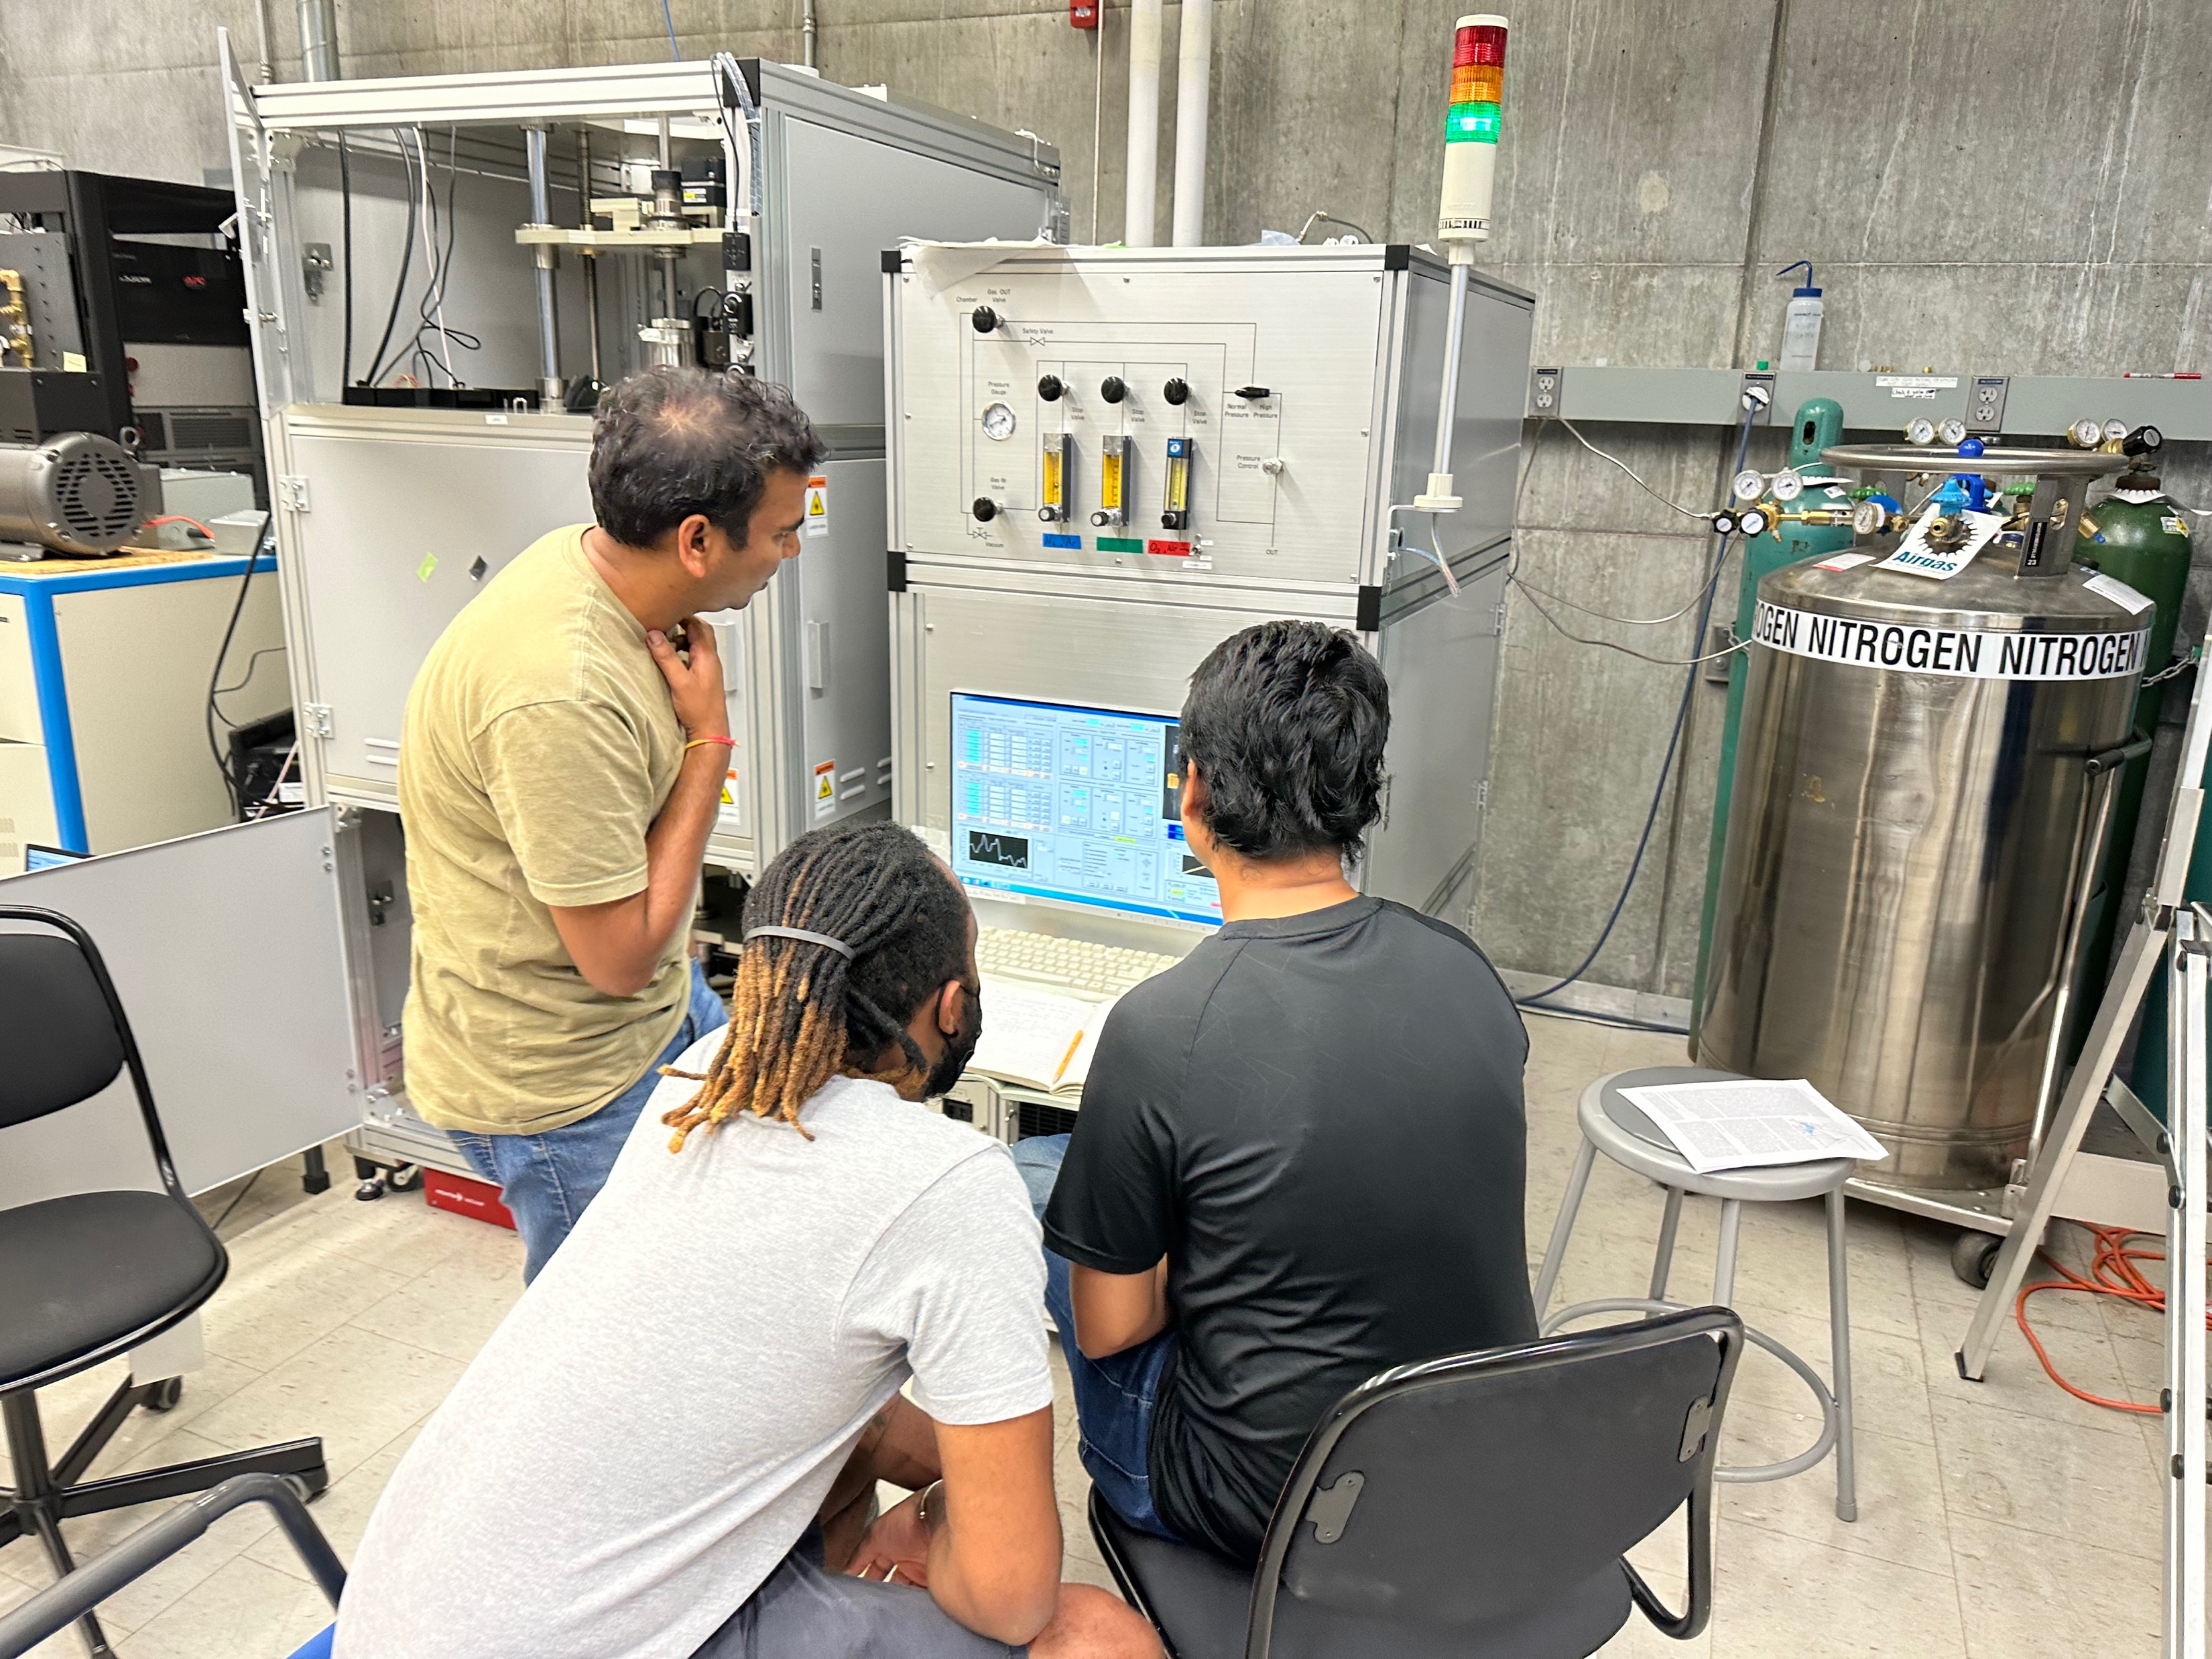
Laser Diode Floating Zone
Notes:
The physical system that we used this summer was a Laser Diode Floating Zone furnace.

Slide 4
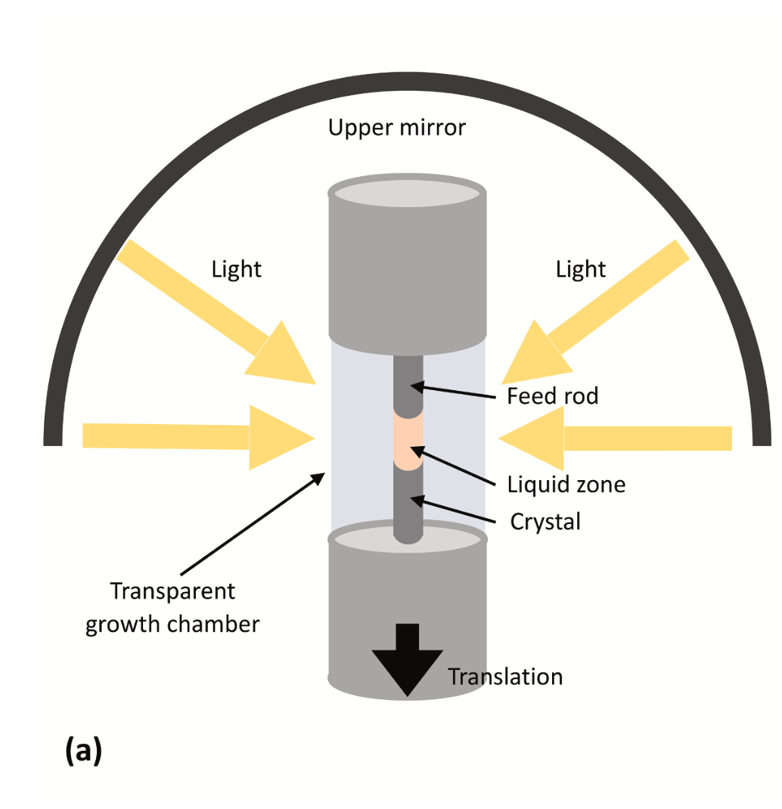
Scott S. Dossa, Jeffrey J. Derby
https://doi.org/10.1016/j.jcrysgro.2022.126723
Notes:
To briefly overview the main parts of a floating zone growth, we have two rods of materials: a crystal solid below and a feed rod above. The ends of the rods are melted by intense light and then joined to form the liquid zone from which the crystal grows

Slide 5
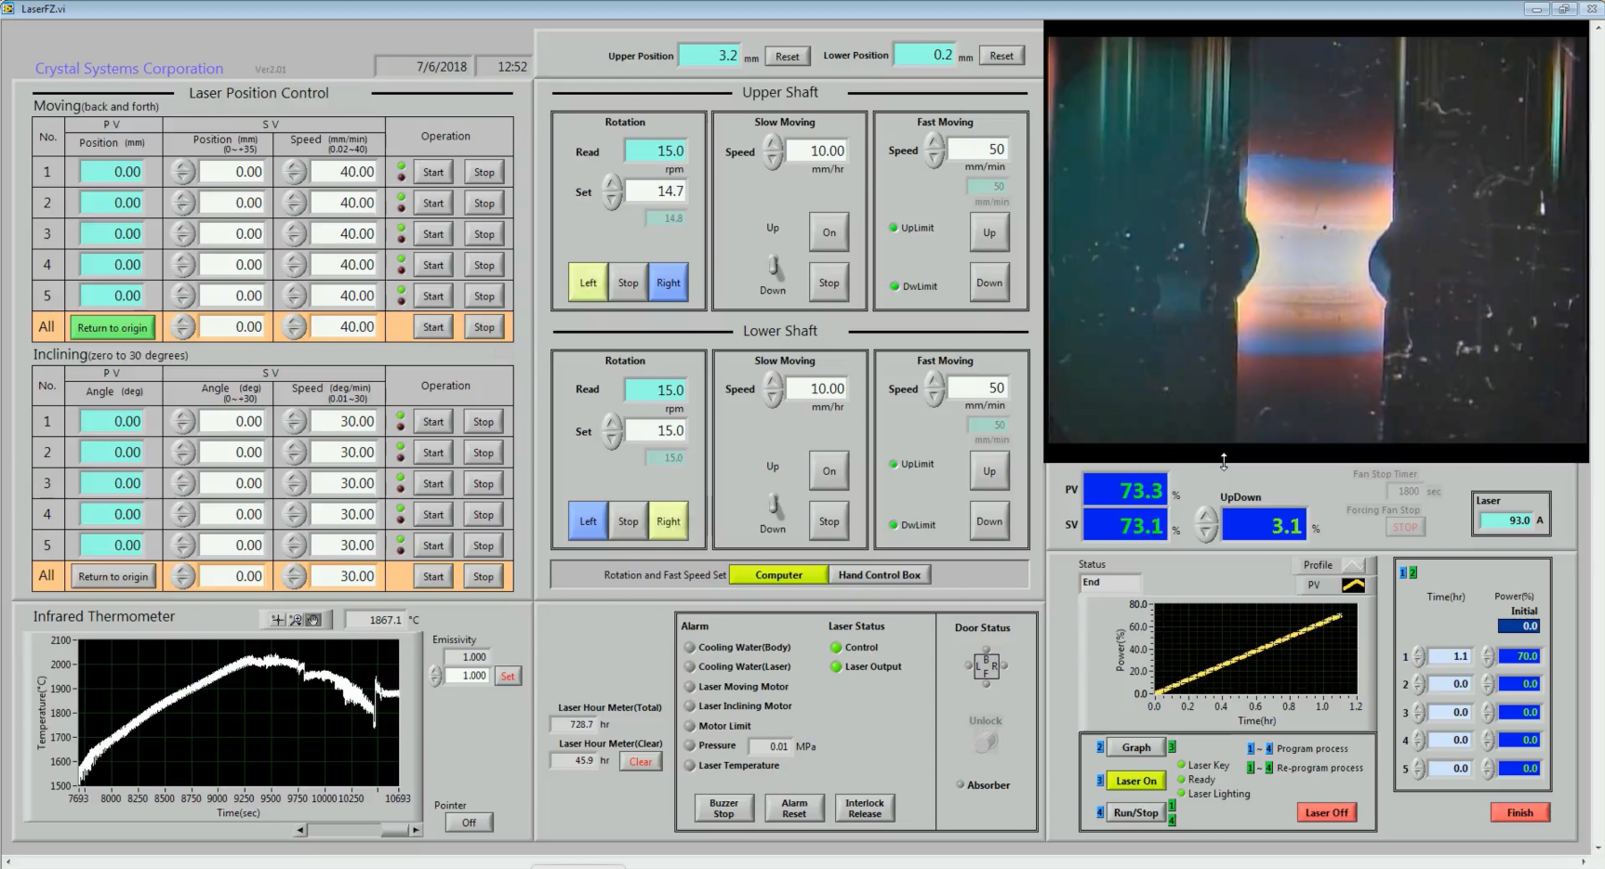
Notes:
Alongside the growth, there’s also the physical controls that the furnace has. This includes the movement of the rods and the heating power

Slide 6
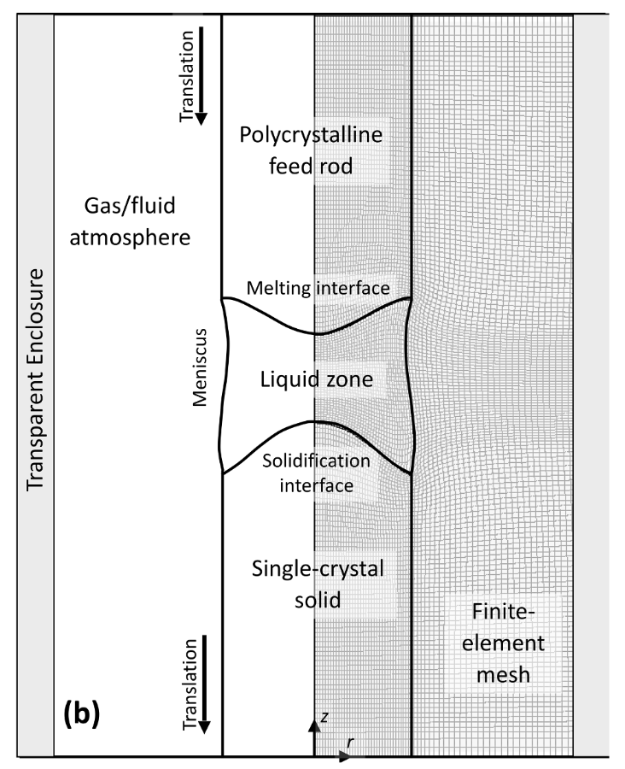
Scott S. Dossa, Jeffrey J. Derby
https://doi.org/10.1016/j.jcrysgro.2022.126723
Notes:
On the digital side, there has been work from Dossa and Derby on modelling floating zone growths. These models put a finite-element mesh on the growth and its surroundings …

Slide 7
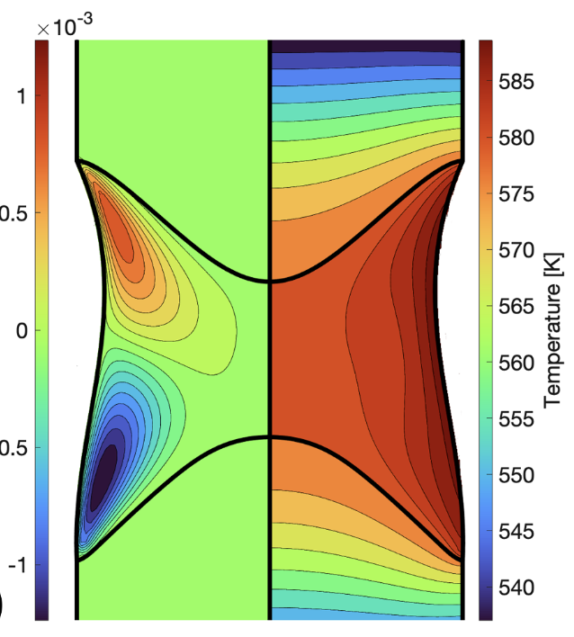
Scott S. Dossa, Jeffrey J. Derby
https://doi.org/10.1016/j.jcrysgro.2022.126723
Notes:
... and evaluate the temperature distribution. The temperature distribution in the molten zone is a critical parameter in the physics of the crystal growth and affects the resulting crystal structure and properties, and so it would be great data to connect the physical growths and digital models.

Slide 8
How can we collect temperature distributions across the molten zone?
Notes:
So, the research question I attacked this summer was “How can we collect data about temperature distributions across the molten zone?” Firstly, I want to clarify why the temperature of the furnace isn’t immediately obvious. In a typical furnace that can be set to some temperature, the entire environment in the furnace is heated to that temperature and you just have to wait for everything inside to reach equilibrium at that temperature. In a floating zone furnace, the sample is directly heated by pumping light energy into it, so how hot it is at any given time depends very much on the material itself.

Slide 9
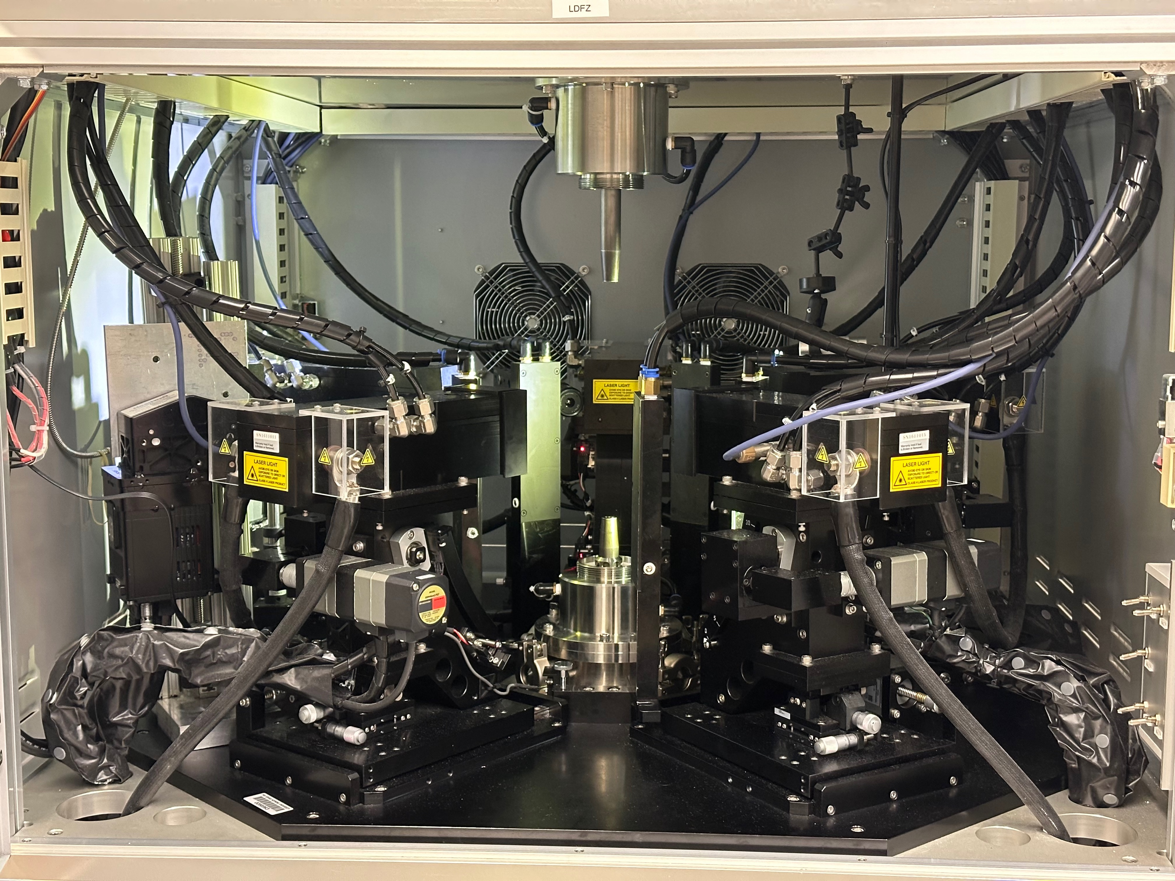
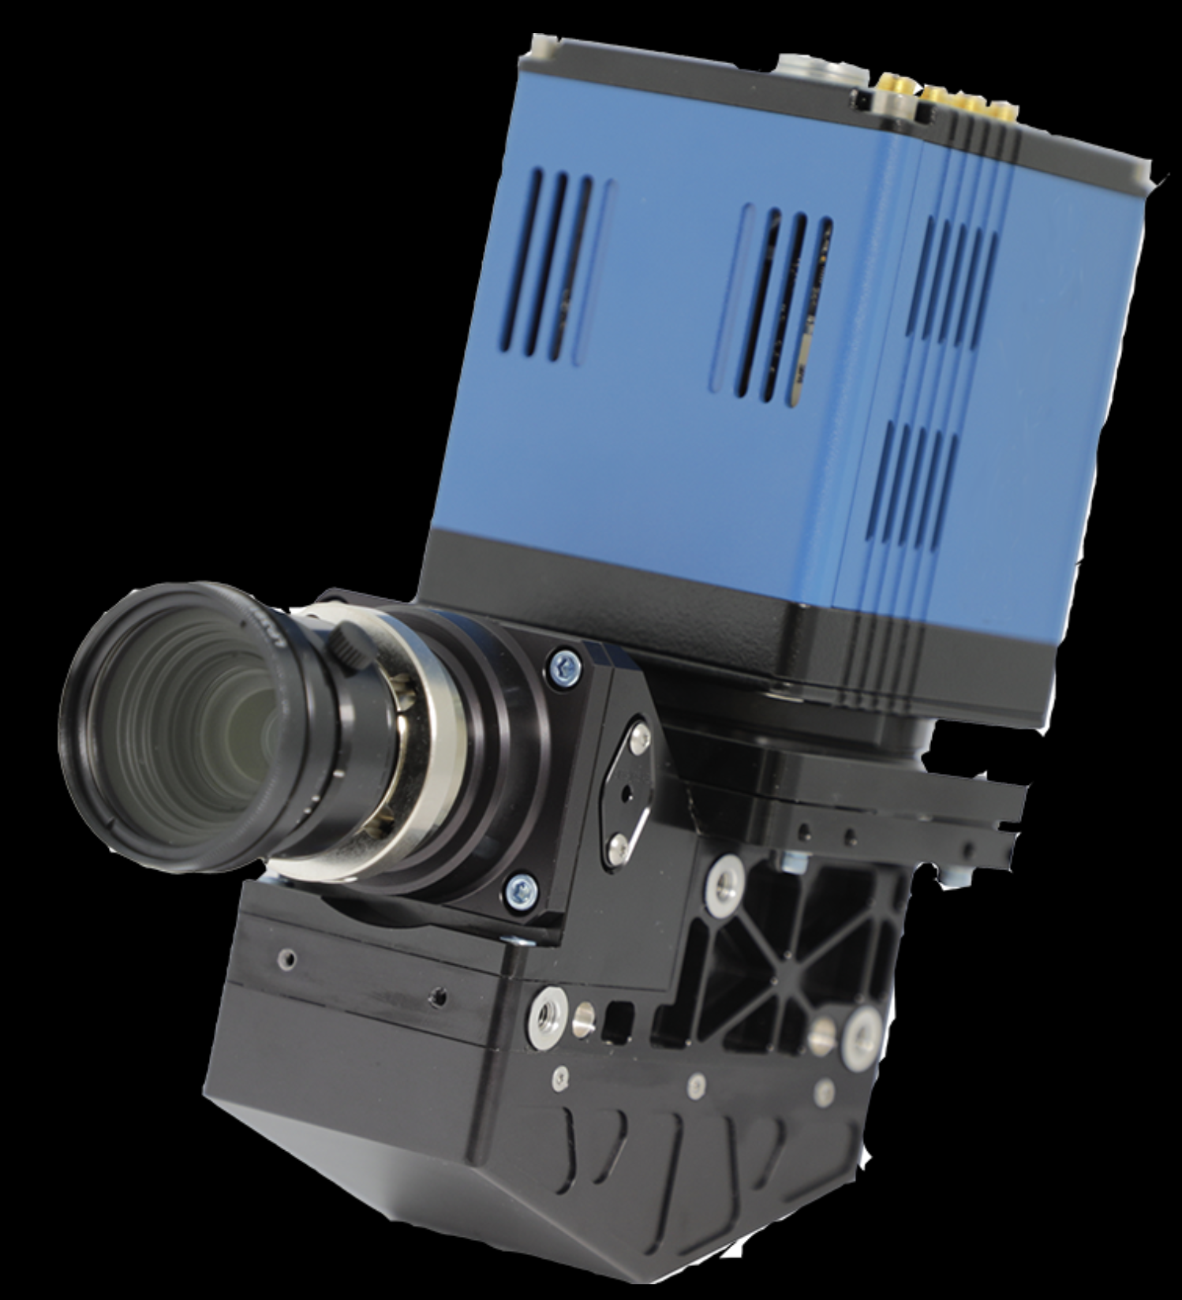
Hyperspectral Camera
Notes:
To do this, we made use of a hyperspectral camera that we mounted in the furnace. Hyperspectral imaging captures a detailed spectrum for each pixel. This particular camera gets over 300 wavelengths.

Slide 10
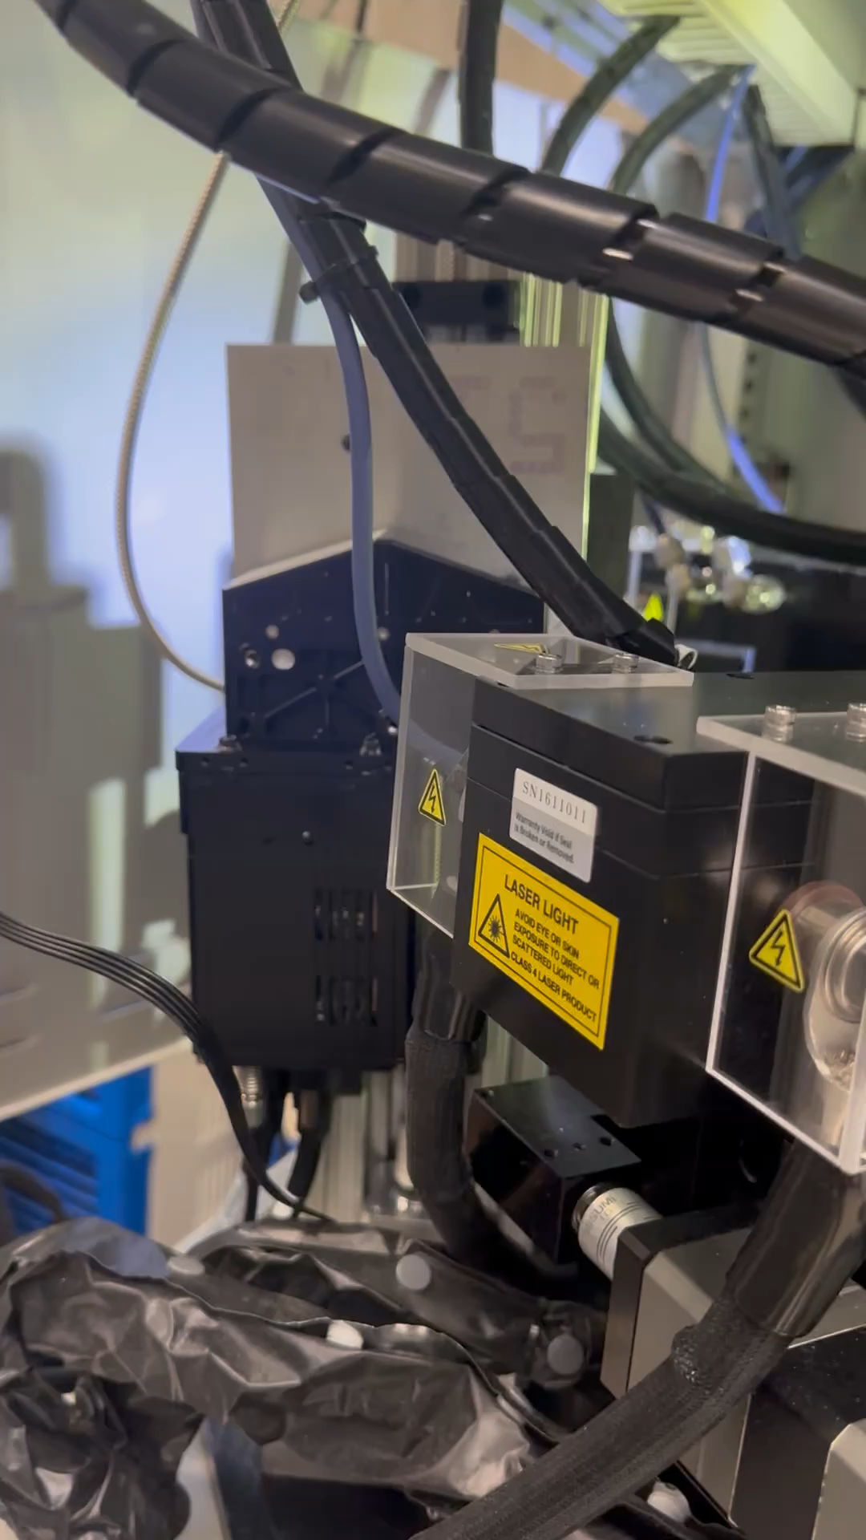
Collect hyperspectral data from the molten zone
Process hyperspectral images into temperature distributions
Create a streaming process for real-time data
Notes:
So, what did I do? First thing is collecting this hyperspectral data from the molten zone. To do that we got the camera mounted in the furnace and moving. The camera has to move because it sees a line rather than a full two dimensional image, so it needs to scan up and down across the molten zone.
Secondly, we need to figure out how to process hyperspectral images and turn them into temperature distributions, which is the data that we are ultimately after.
Finally, we want to create a streaming process for the collection and analysis so that we can get results back in real time.

Slide 11
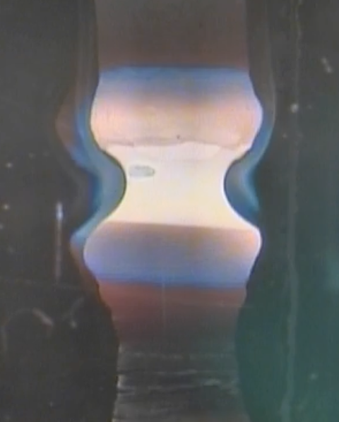
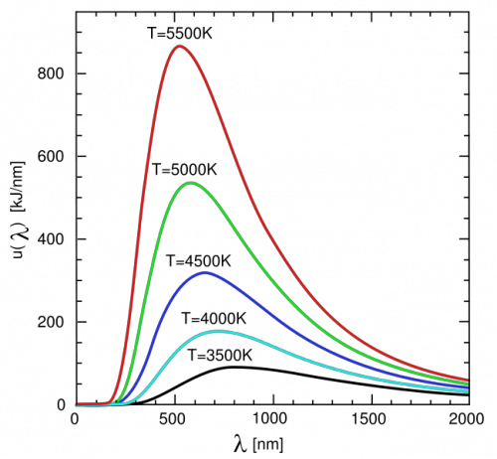
Pyrometry
Blackbody
Notes:
For the analysis we need to develop a pyrometry method to calculate temperature from a spectrum. The key observation for this is that the hot, glowing material in the growth is a blackbody, and as such is emitting a blackbody radiation spectrum. Blackbody spectra are completely unique depending on the temperature of the object, so in theory this contains all the information we need to get the temperature.
To determine the temperature from the spectrum, we’ll use a standard least squares regression to fit the spectrum we measure for each pixel to a blackbody spectrum, and this will optimize temperature as a parameter for the fitting.

Slide 12
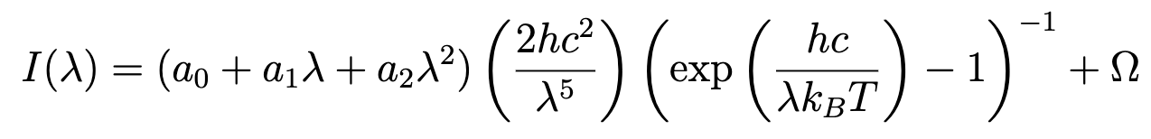
Blackbody Model Function
Emissivity, Scaling
Stray Light Offset
Parameters
Dong-Xia Qu, et. al.
https://doi.org/10.1103/PhysRevApplied.14.014031
Notes:
So, what is the equation that we want to fit our data to? I want to break down the pieces.
First, we have the core of the blackbody equation which comes from physics theory. We take the wavelength as the independent variable and the output is intensity. The dependence on wavelength, temperature, and the various constants is what makes the unique blackbody shape, which we saw on the last slide. There’s a few added pieces.
The first thing is this term on the right. There’s a multiple ideas wrapped into this term. First is that the intensity needs to be scaled by the emissivity of the material, which will be different for different growths. Additionally, emissivity can vary with wavelength. This paper implemented a similar fitting process for metals, and they indicated that a quadratic dependence on wavelength is a good approximation. However, this term isn’t pure emissivity. The intensity values measured by the camera are relative and do not match up with any consistent set of units for the various fundamental constants we have in this equation, so this term also accounts for that scaling.
What we added to this equation after testing is this constant offset at the end. We did some testing that I’ll talk about more in the next slide. In an ideal blackbody spectrum, the intensity approaches 0 as the wavelength goes to 0. However, this was not the case in the data. Firstly, stray light in the data can move the spectrum up or down. In a lot of spectroscopy methods, you correct the reading against a blank to isolate the sample of interest. This camera uses a different correction method that adjusts the intensity values relative to each other but doesn’t completely eliminate stray light. We found that a lot of the data had a constant offset, so we add that as a parameter to the fitting.
Finally, we have temperature, which is what we are interested in.

Slide 13
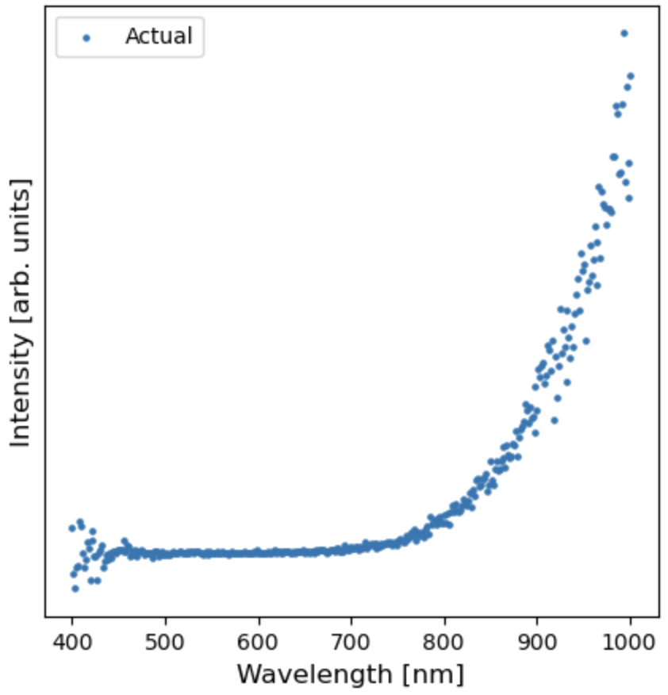
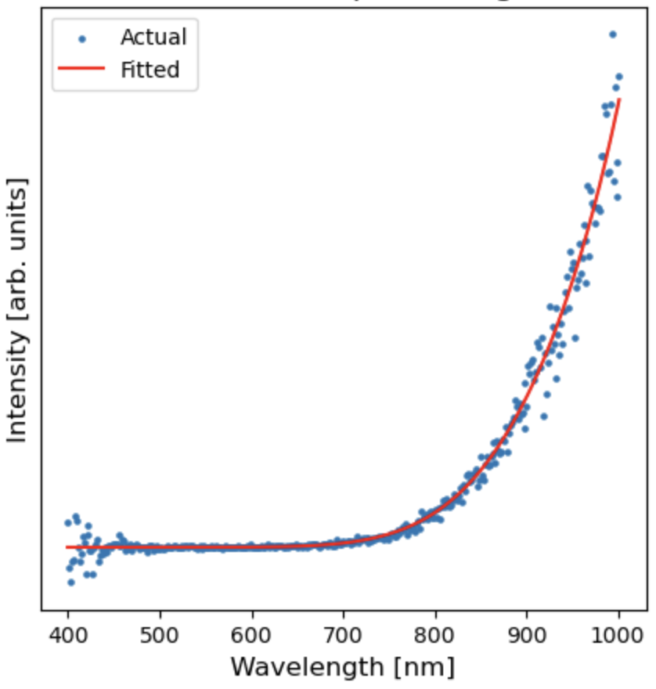
Data
Fitted with T=807 K
Notes:
So, let’s take a look at how this works. Here’s a spectrum that we measured during testing. If we run the regression, we get a nice looking fit and a temperature value of about 530 C. We verified the temperatures by using a handheld contactless pyrometer to read the temperature, and found that these matched up. So, now that we have a reasonably functional method, we would like to get an image from the furnace. Unfortunately, reality got in the way and we weren’t set up to take images until 2 weeks ago. So, in the meantime, I set up the streaming process.

Slide 14
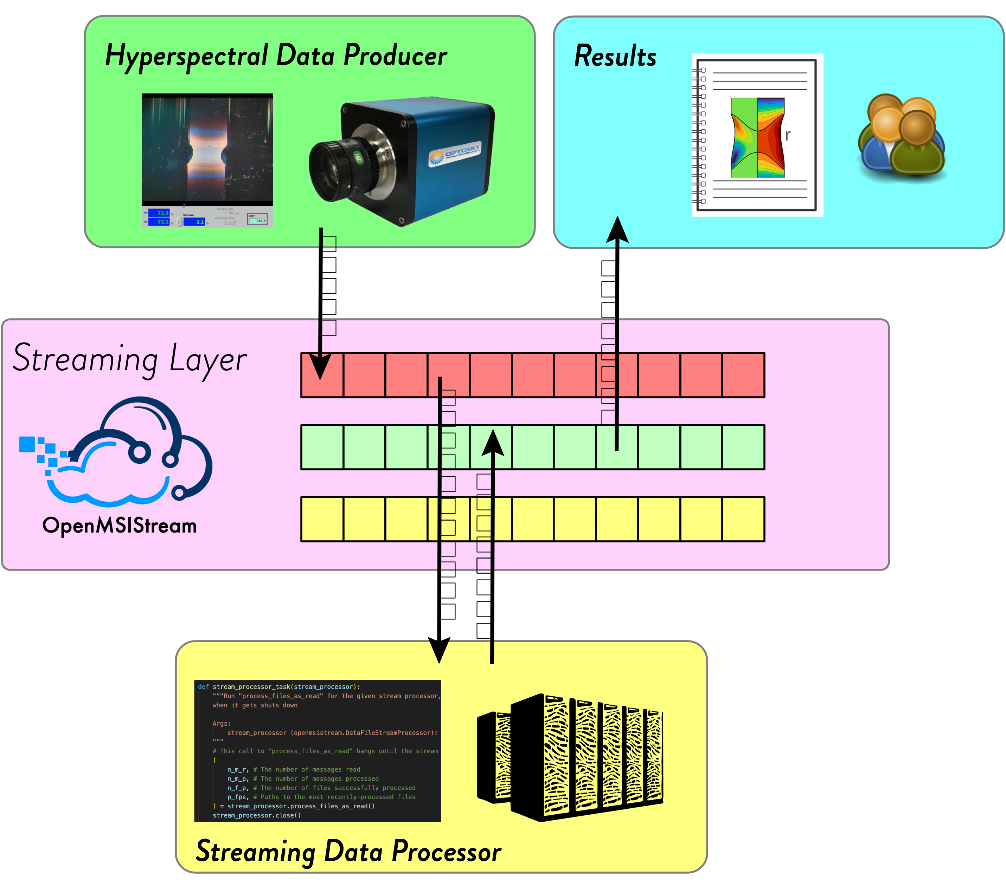
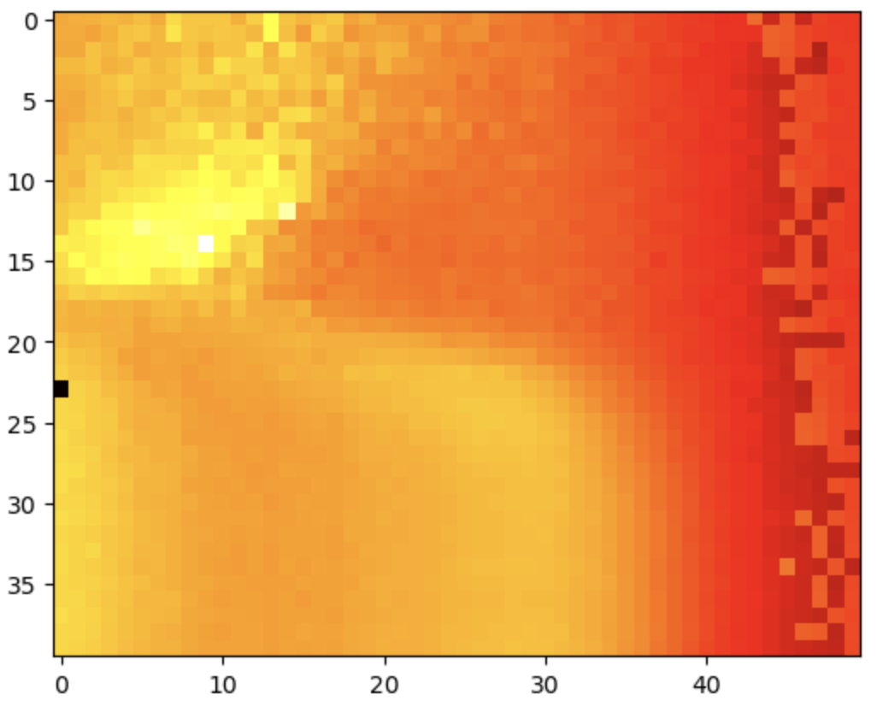
Notes:
We use something called data streaming. When the image is captured by the camera, it is automatically streamed out to a server. From there, the data is consumed by a stream processor that’s hosted on one of our paradim servers. There, the raw data is both stored in a database and also analyzed. The resulting temperature distribution is then streamed back out to the third party and then back to the lab so that the people doing the growth can see the results in real time.
Now that everything is set up, we can put the camera in the furnace and hit go, and things will pop out.

Slide 15
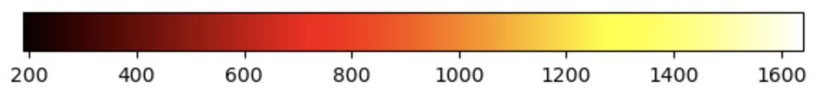
Kelvin
Notes:
This is the first good image I got from a growth. You can see there’s still some adjusting needed, mainly that we’re not seeing the entire molten zone, but we get a nice chunk and we can make out the molten zone shape that I’ve outlined there.

Slide 16
Kelvin
Notes:
We also see there’s various hotter and cooler parts, and the temperature varies a substantial bit bit from around 1100 to 1600 C. That bright spot there would probably be where the lasers are most intensely hitting, and then other distributions. So, this is what I got to this summer. There’s a few obvious next steps. First of all, adjust the camera positioning and get it seeing the entire molten zone.

Slide 17
Next Steps
Collect variety of data
Validating temperature readings
Reducing and filtering failed regressions
Notes:
After that, the big next step is to just start collecting lots of data. Because we set up this streaming system, it’s very easy to collect data and get initial analysis, so start pumping out images. Then, it would be good to look more closely at the images and see if the process for getting temperature needs any adjustment. I did my development based on the graphite rods outside the furnace, but we should look at if there are any adjustments needed for being in the furnace.
How precise are the temperature values? How much noise is the camera picking up? Does the limited wavelength range cause any issues?
As David likes to say, we’ve put our foot in the door, and now we can experiment, collect data, and make improvements.

Slide 18
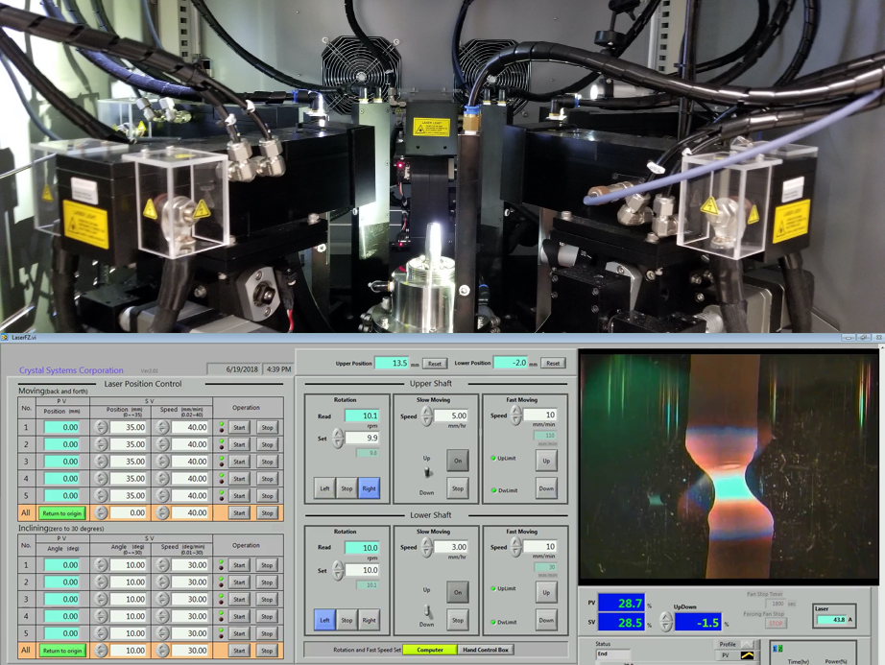
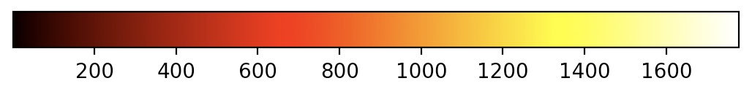
Physical
Data
Digital
Measurement
Predictions
Promising growths
Model validation and updating
Notes:
From there, we can take a look at the big picture to see some bigger next steps. This data is measured from physical experiments, and it can now be used to inform and validate the digital models that we talked about. Going the other way, we now speak a common data language so we can take the predictions the models dive and use them to inform future growths. Those growths in turn create more data, and the cycle of experimentation and improvement continues.

Slide 19
Acknowledgements
Physical
Data
Digital
Evan Crites (McQueen Lab, PARADIM)
Maggie Eminizer (IDIES)
NSF Awards #2039380 (PARADIM) and #2129051 (VariMat)

Slide 20
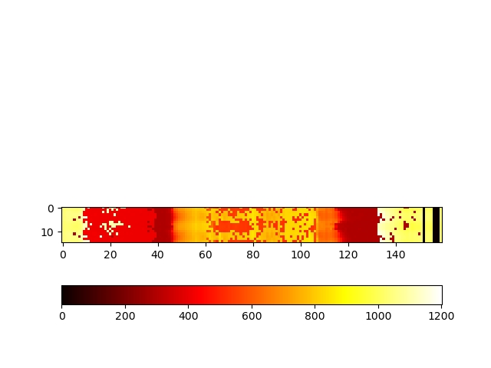
Into the furnace
Kelvin
20
Notes:
So, taking this analysis into the furnace, here we have an image from a growth. There’s not much to see in the png because this growth was too dark to see much. We can fix that by increasing the exposure time, but it turns out that we are still able to get temperature well with a low exposure, so I stuck with that. Also, because we set up all the automation, this is super easy to run. I clicked capture image, waited, and got back this heatmap. **Talk about what this is looking at, what we see**

Slide 21
Physical
Digital
Data
“Dynamically updated with data from it’s physical twin”
“Bidirectional interaction”
“Informs decisions that provide value”
Notes:
This hits on the last

Slide 22
Physical
Digital
Autonomous Experimentation
Data

Slide 23
Extra Slides – Carbon Rod Fitting

Slide 24
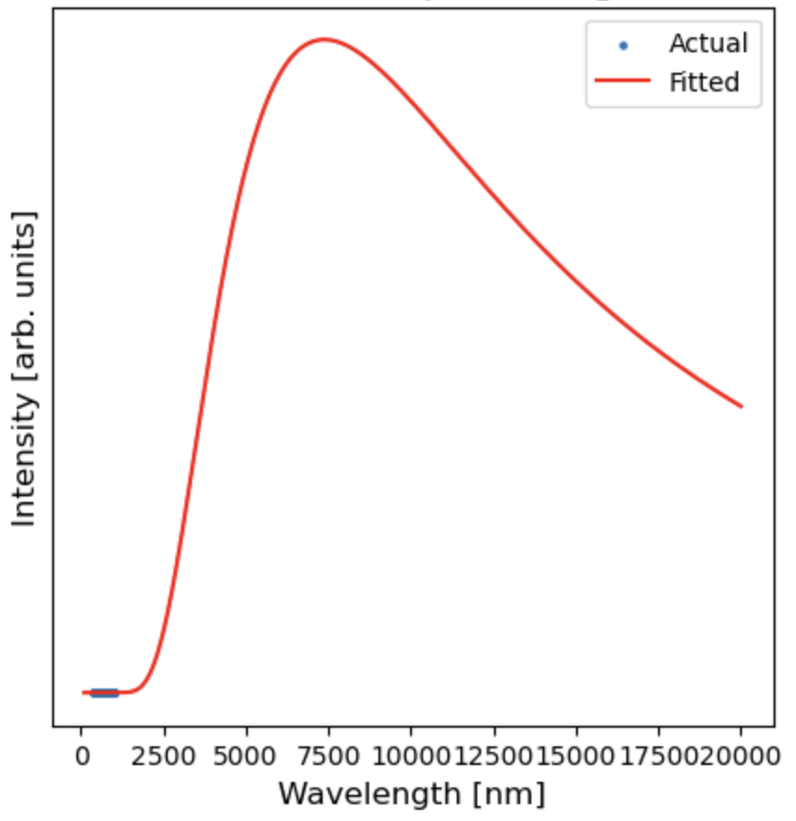
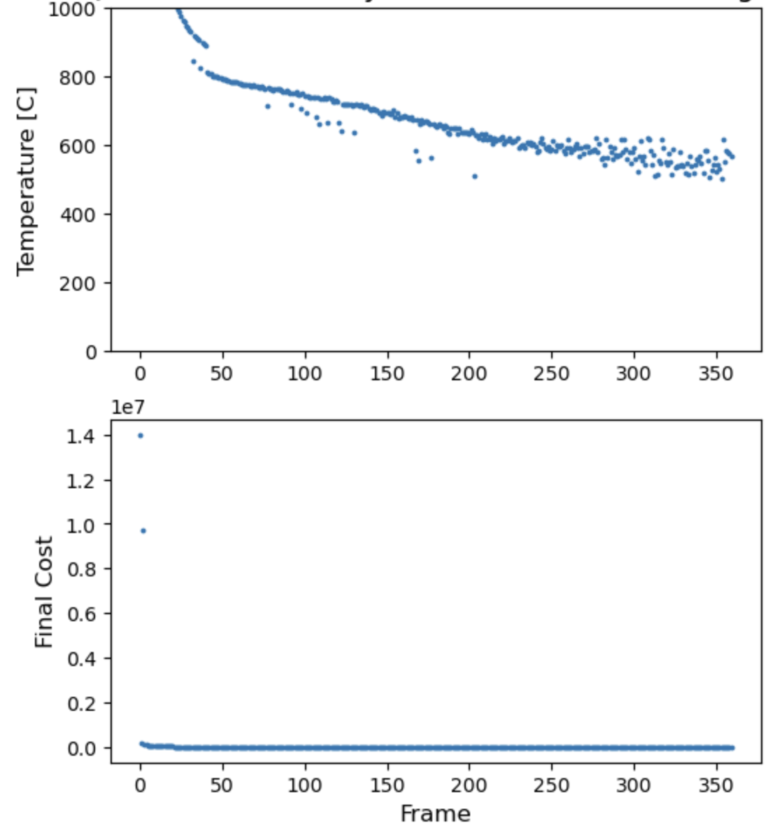
Notes:
This is some testing we did where we heated up a graphite rod to 1000

Slide 25
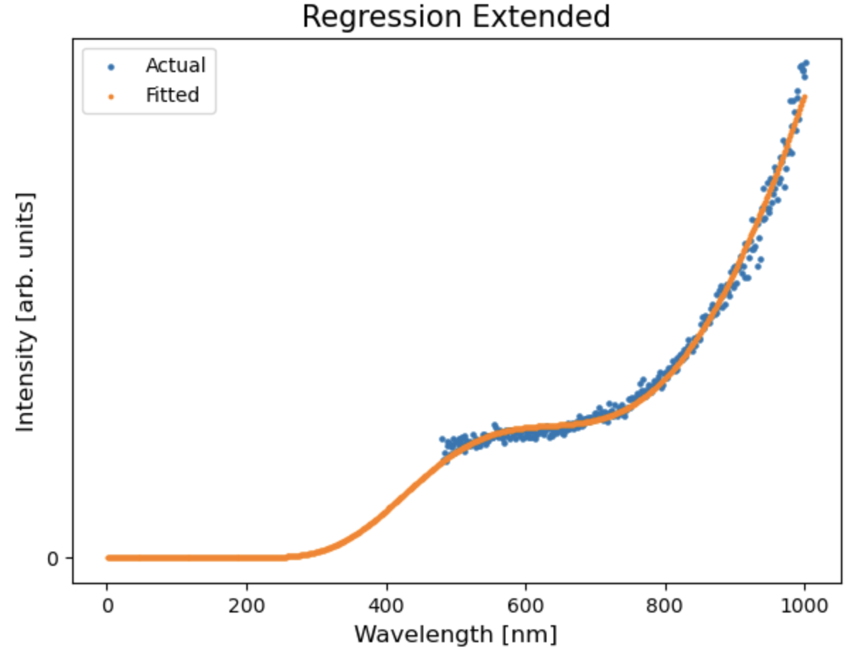
Overfitted
25

Slide 26
Extra Slides – Full Resolution

Slide 27
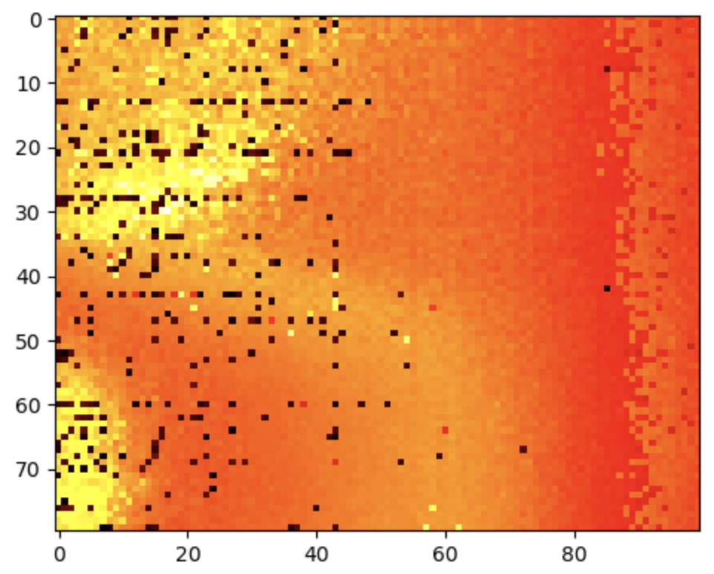

Slide 28
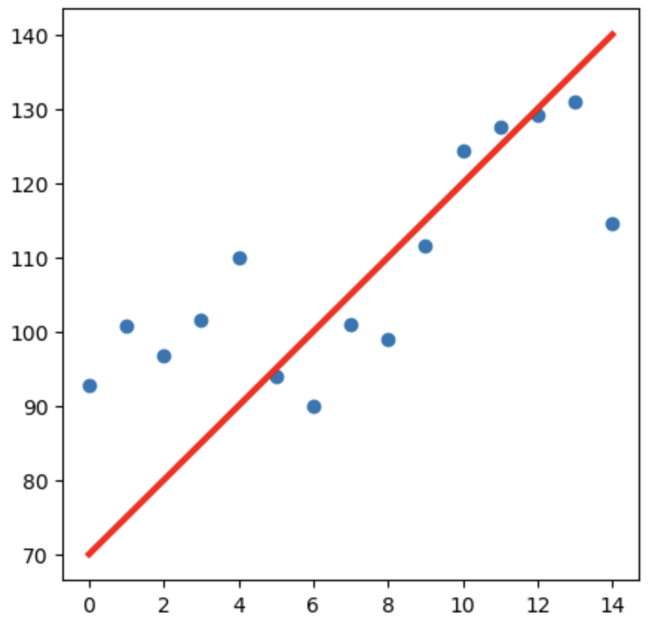
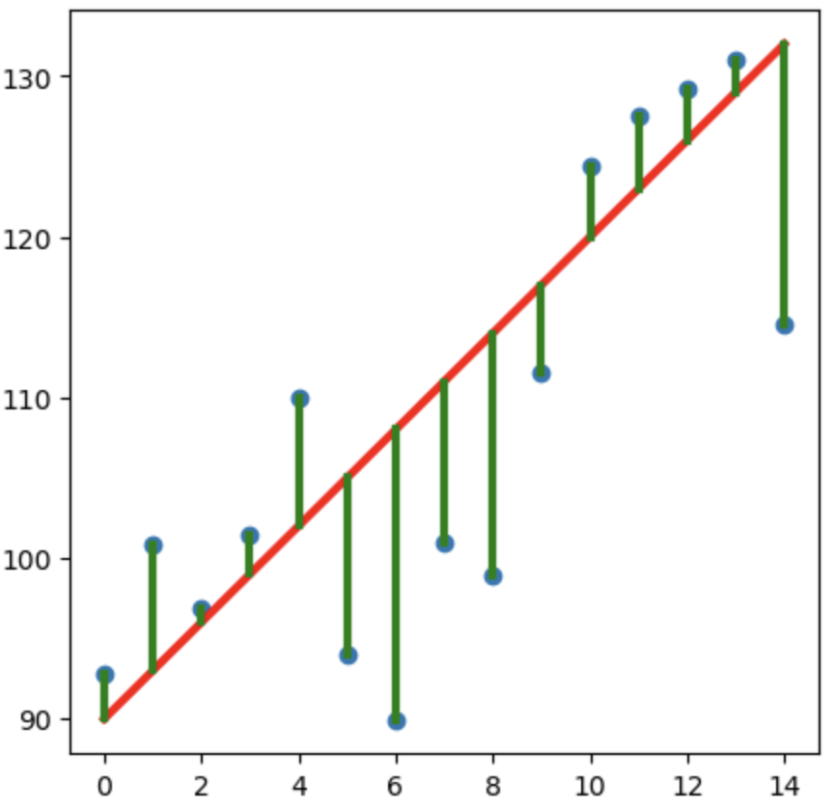
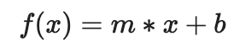
Least Squares Regression
Model Function
Guess Parameters
Minimize Residuals
Parameters
Notes:
To do this, we can use least squares regression. With this regression method, we start by providing a model function, which we know for blackbody radiation. The regression than optimizes parameters of the function, which will include temperature that we want. We then guess some parameters, getting a bad fit, but the residuals are minimized and parameters optimized to get the best fit. There’s lots of code already written to do the last part, so what we need to do for this specific usage is figure out what the model function should be.

Slide 29
Extra Slides – Other Carbon Rod Spectra

Slide 30
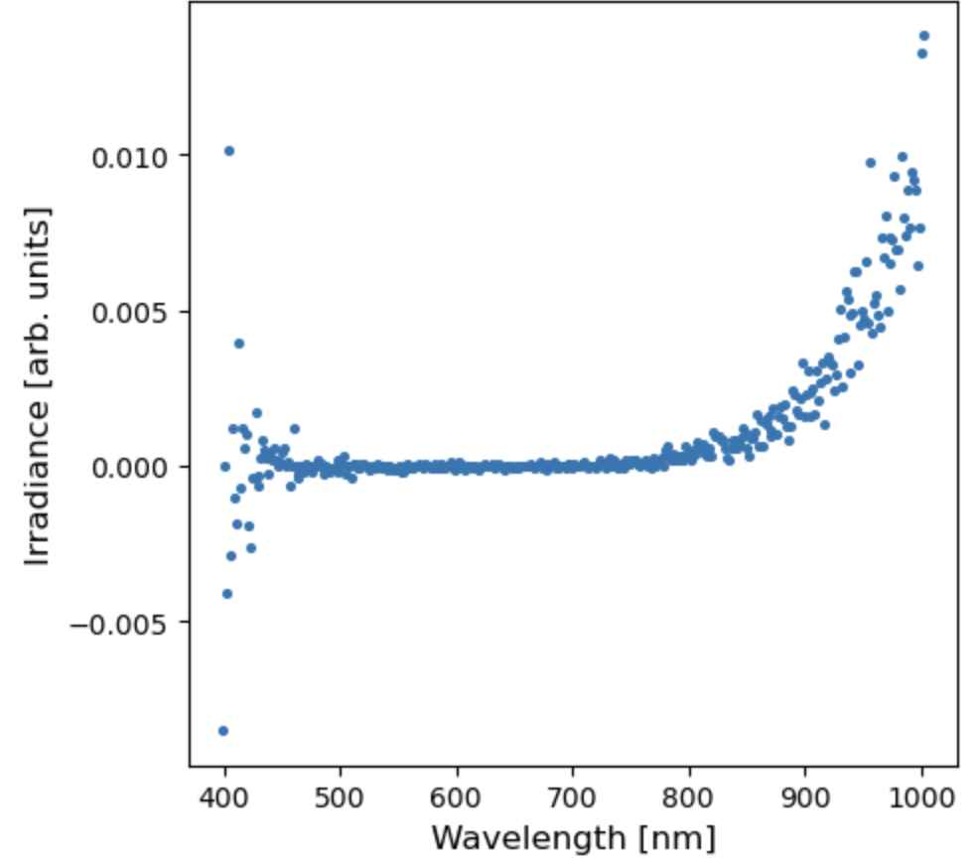
Carbon Rod Corrected

Slide 31
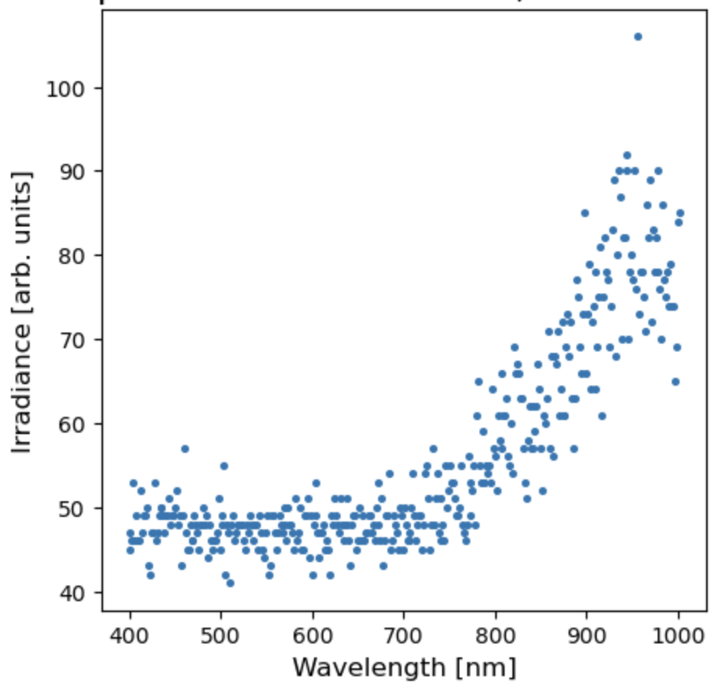
Carbon Rod Uncorrected

Slide 32
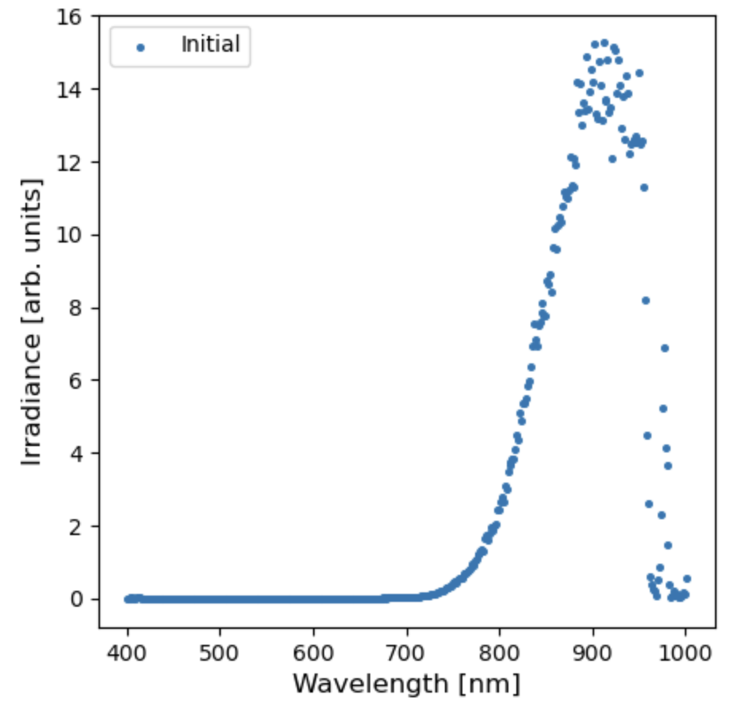
Notch Filter Dip

Slide 33
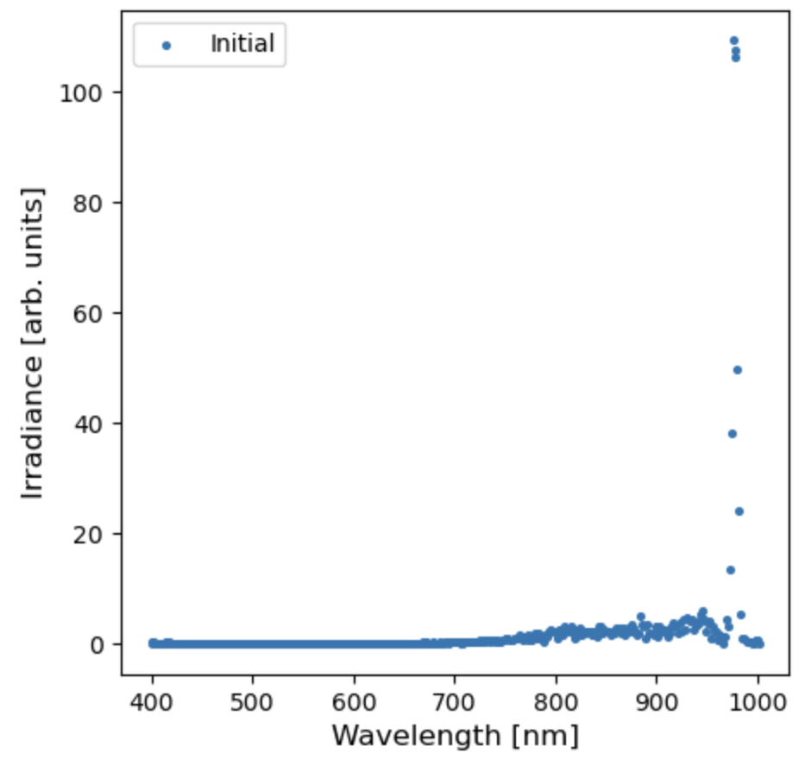
Laser Light Spike

Slide 34
Extra Slides – Camera Motion

Slide 35
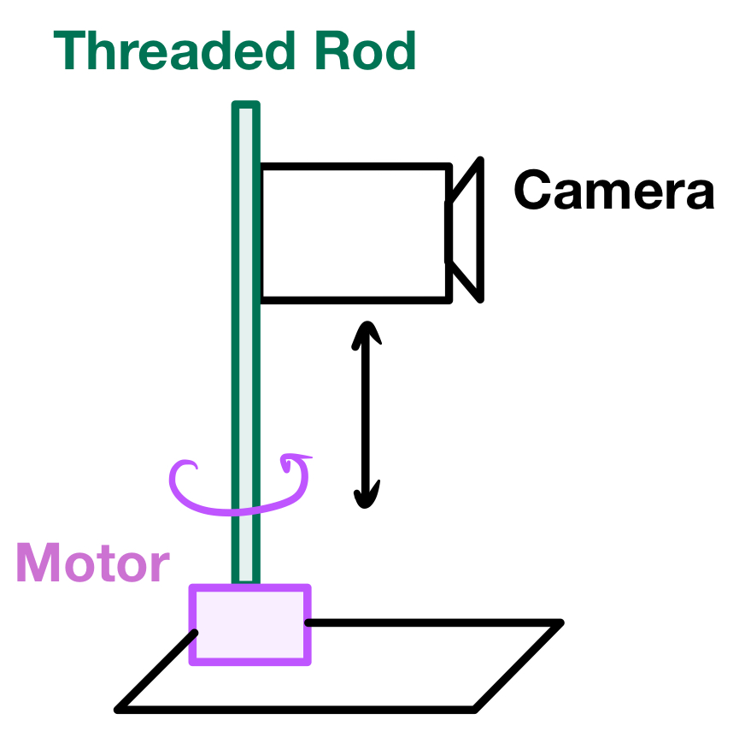
Notes:
How do we make it scan?

Slide 36
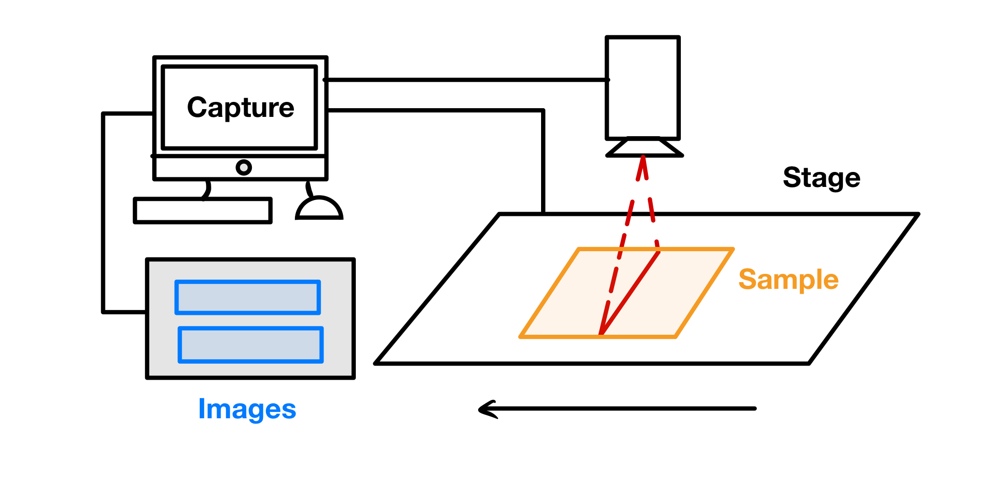
Notes:
Why does it need to move?
Important to note that the computer syncs the start of the image capture and the movement of the stage

Slide 37
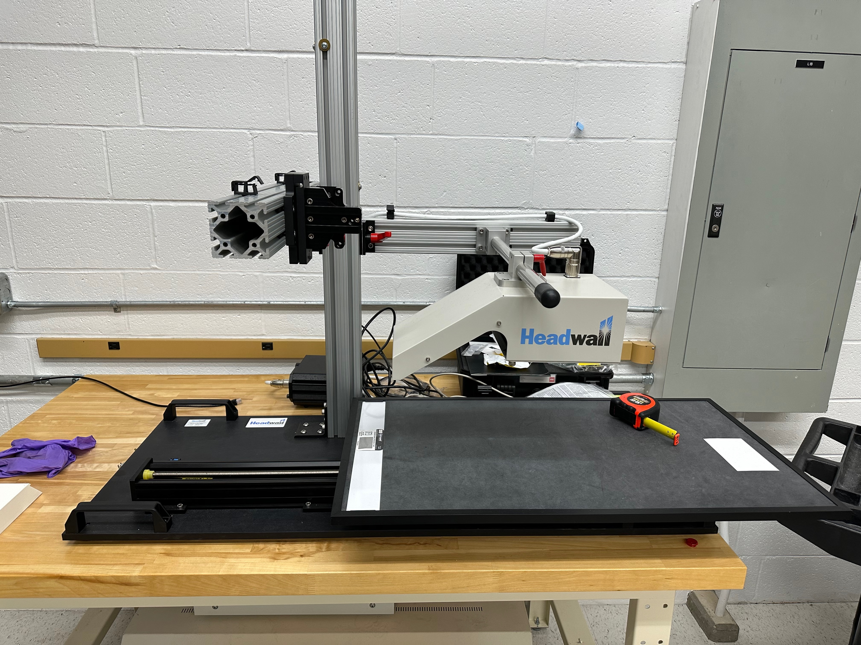

Slide 38
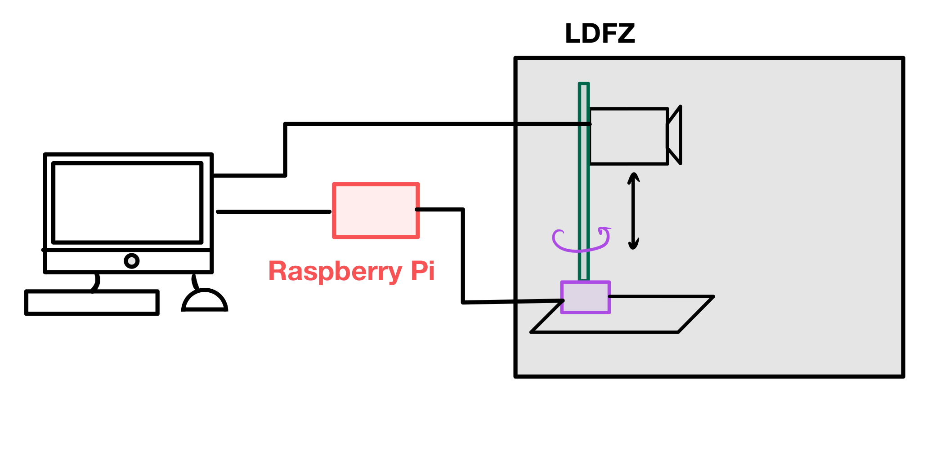
Notes:
How do we sync the motor with the image capture? We are replacing the stage with the motor

Slide 39
Extra Slides – Streaming

Slide 40
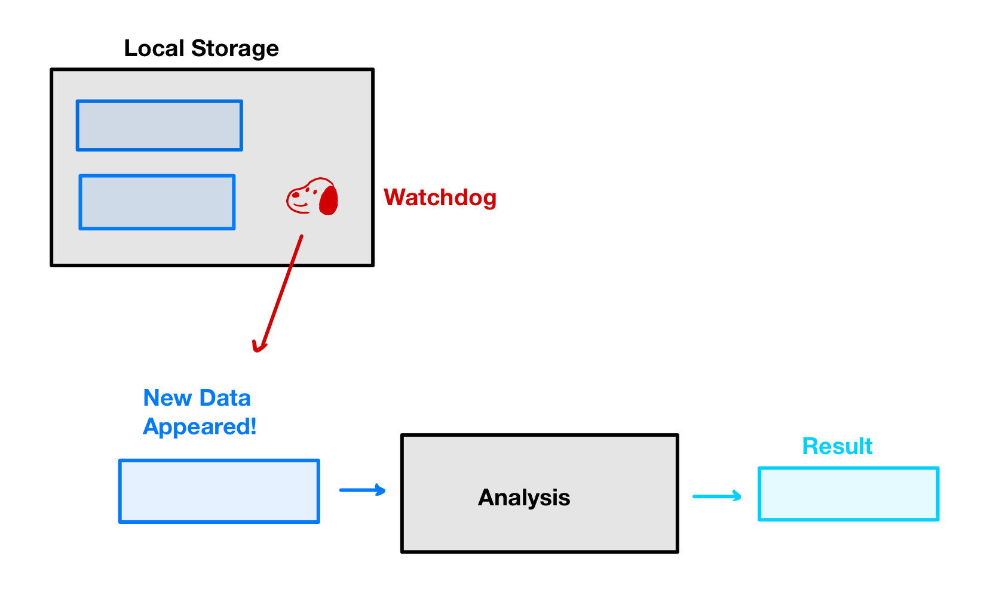

Slide 41
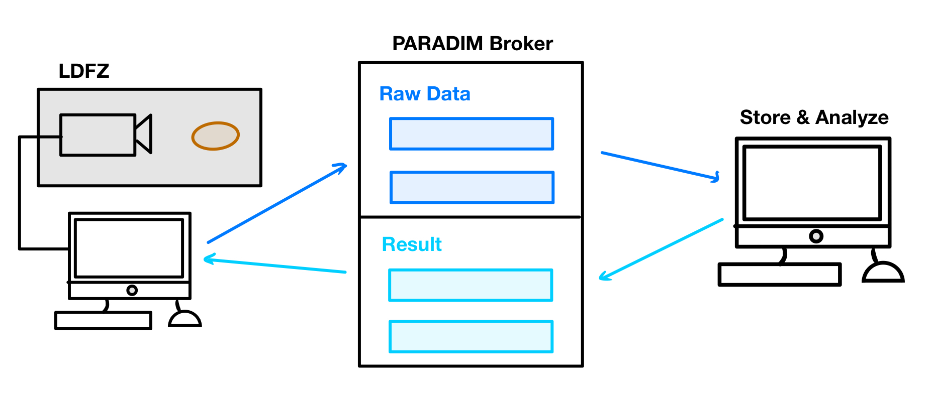
Notes:
Animate in one piece at a time

Slide 42
